Slide 1

Cyclistic Bike Share
Preliminary Data Analysis on maximizing membership
Last Updated: October 6th , 2022

Slide 2
Goals for the presentation:
1
2
3
Define the objective (What are we talking about?)
Determine key differences between casual and annual members
Discuss potential areas for further development
We will define the primary goal that this presentation aims to resolve
We will look at factors such as demographic, ride length and distance to determine what sets these two groups apart
We will discuss what we can do as a company to take advantage on this current situation to convert casual members to membership

Slide 3
What are we talking about?

Slide 4
Objective
Determine how casual members use the service differently than annual members to encourage casual members to subscribe to the annual membership

Slide 5
So how are they different?

Slide 6
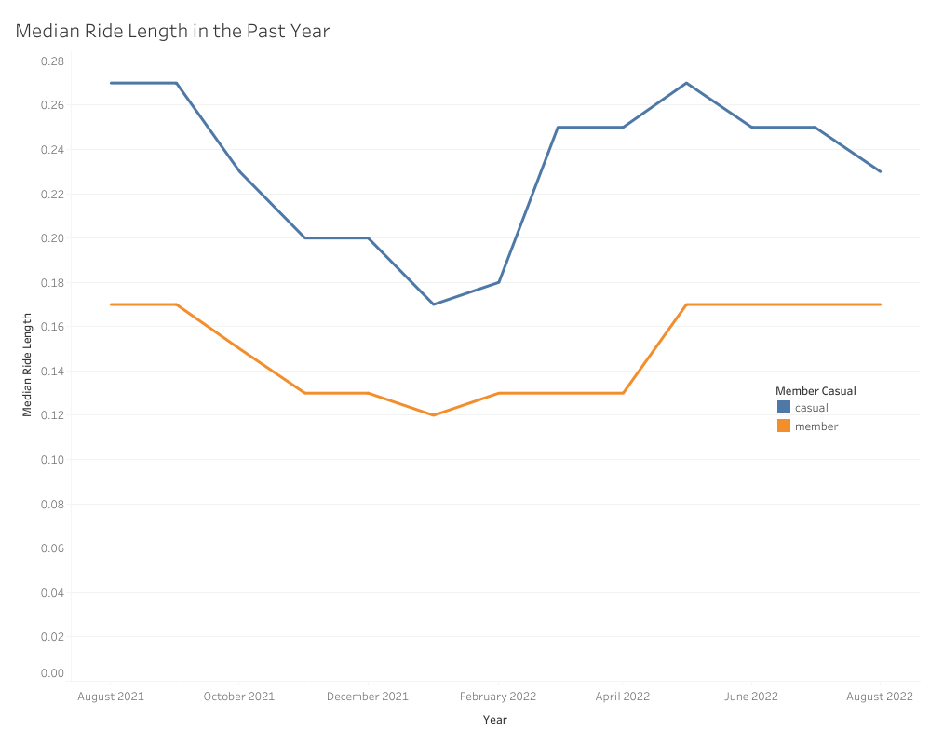
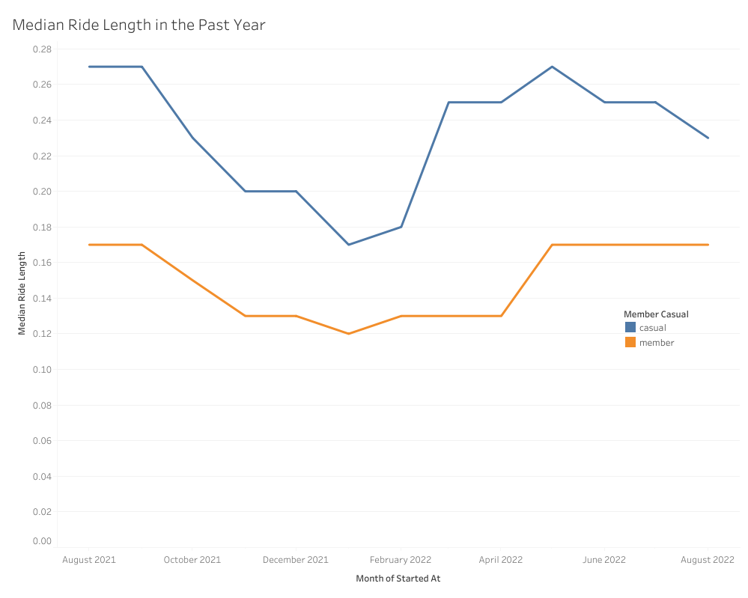
Historical trend of ride length between membership
Casual riders spend more time in a single session than an annual member
Casual riders typically spend 6 minutes more than annual members
Notes:
We used the data from our company’s internal records of userbase information (Note: The datasets have a different name because Cyclistic is a fictional company. For the purposes of this case study, the datasets are appropriate and will enable you to answer the business questions. The data has been made available by Motivate International Inc. under this license [https://ride.divvybikes.com/data-license-agreement]). Security measures were applied to prevent sensitive personal information from being identifiable in protection of customer privacy. This data contains information in the past 12 months from August of 2021 to August of 2022 and contains information of the users such as type of bike used, station started/ended, membership status, ride length, day of the week the service was used, and the distance travelled.
The visualization uses median as its value of measure because several outliers were present in the data which could skew the average. Therefore, a more robust measure of median was used as an alternative (for the measure of central tendency). The x-axis shows the past 12 months, and the y-axis shows the ride duration (how long the user spent on the bike in a single session). The line describes the median ride duration for each month.
We see that casual riders have historically spent more time in a single session than annual members. When comparing the duration, the casual members spend 6 minutes more than annual members (comparing medians).
This pattern persists when we compared distance travelled in the past 12 months

Slide 7
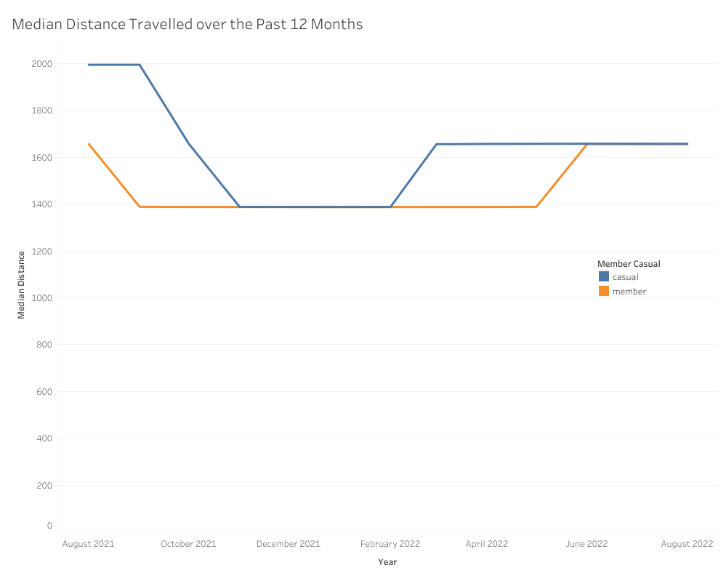
Historical trend of distance between membership
Casual riders travel further than annual members
Casual riders typically travel 270 meters more than annual members
Notes:
Using the same data as before, we also adjusted to median in this plot as well exploring the median distance travelled the past 12 months
We see a consistent pattern of casual members travelling further distances than members with several instances where both members travel roughly the same amount of distances.
On average, casual riders have historically travelled 269.4 metres more than annual members (using median)
So then, where would casual riders go when they use the service?

Slide 8
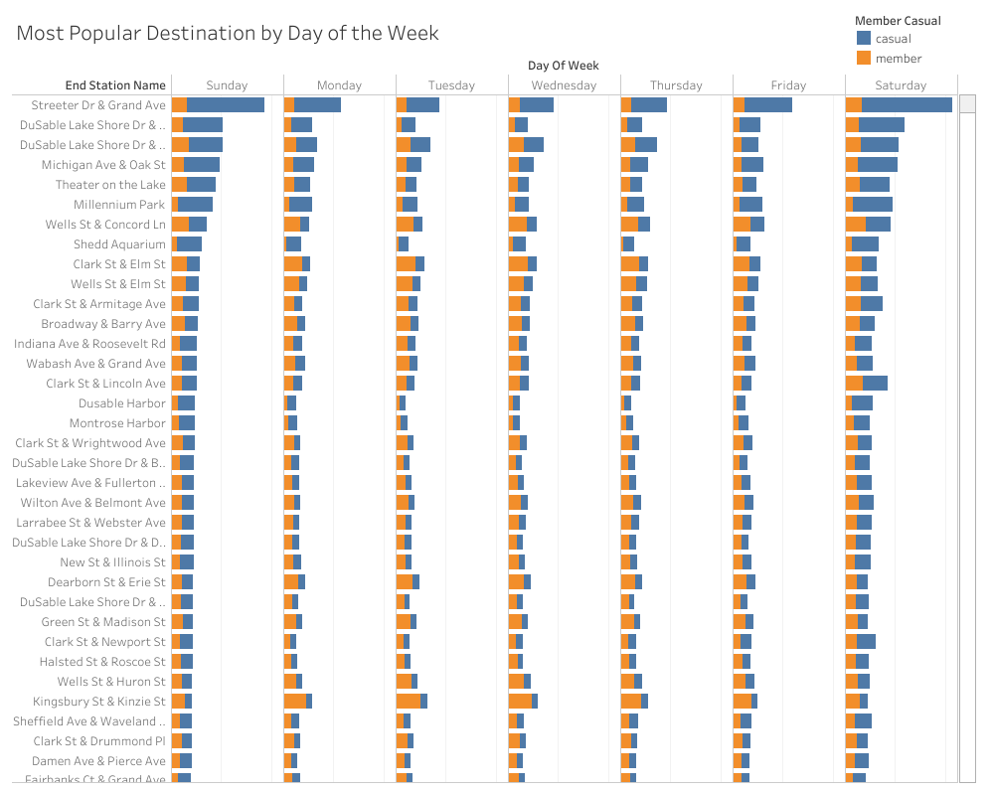
Most popular destinations for users
Most of the activities booms during the weekend
Casual riders use the service more often for popular locations which also happens to be attractions
Casual riders appears to use the service to travel to various attractions
Notes:
We see two things here. First, most activity seem to happen during weekend.
Second, we see that casual riders use the service more often during weekend for the top 5 popular locations which also happens to be located near an attraction (e.g., parks, theatres, docks). This may imply that casual riders typically use the services to travel during the weekend.
Another interesting insight in this plot is how the annual members use the services more frequently during weekdays than casual riders. This might indicate that annual members may use the service more regularly as a way to commute (to work). This assumption needs to be tested further, however, if true this hypothesis may also explain why annual members spend less time/distance than casual riders (maybe they live closer by to a bike station?)

Slide 9
So, what can we do?

Slide 10
Based on our preliminary analysis:
1
2
3
Casual riders typically use the service longer than annual members
Casual riders typically travel further than annual members
Service is used most often during weekend by casual riders

Slide 11


So, what can we do based on our analyses?
Promote campaign to incentivize casual riders to use the service more regularly
Eco-friendly campaigns
Installing more stations
Notes:
We may be able to convert casual riders to annual members by promoting campaigns to incentivize casual riders to use the services more regularly outside of weekends and to visit attractions. This could include promoting eco-friendly agendas (e.g., encouraging uses of bikes as a commute than vehicles) or installing more stations in residential districts where users can access the services more easily

Slide 12
Limitations
Assumption of normality is violated for the two-sample t-tests
With the given data, it is difficult to answer questions such as:
Why do the annual members have less hours and distance travelled?
Can we tell whether some members are using more regularly than others?
It remains an assumption that casual riders use the service to travel to attractions
Ideas for future projects could aim to determine whether some users use the service more frequently than others as well as determine if distance from bike stations to place of residence increase service usage

Slide 13
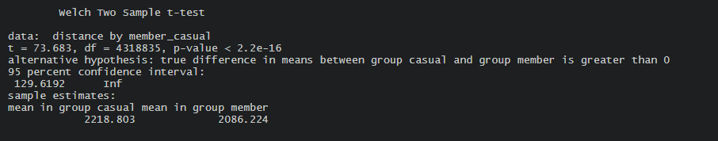
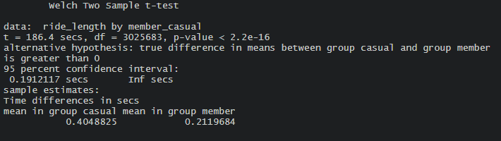
Appendix
One-sided two sample t-test comparing distance between casual and annual members
One-sided two sample t-test comparing ride length between casual and annual members
Notes:
The p-values for both suggest that the differences of distance and ride length between casual and annual members are statistics significant.

